Slide 1
C. D. BROAD’S “THE ARGUMENT FROM RELIGIOUS EXPERIENCE”

Slide 2
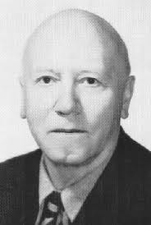
CHARLIE DUNBAR BROAD

Slide 3
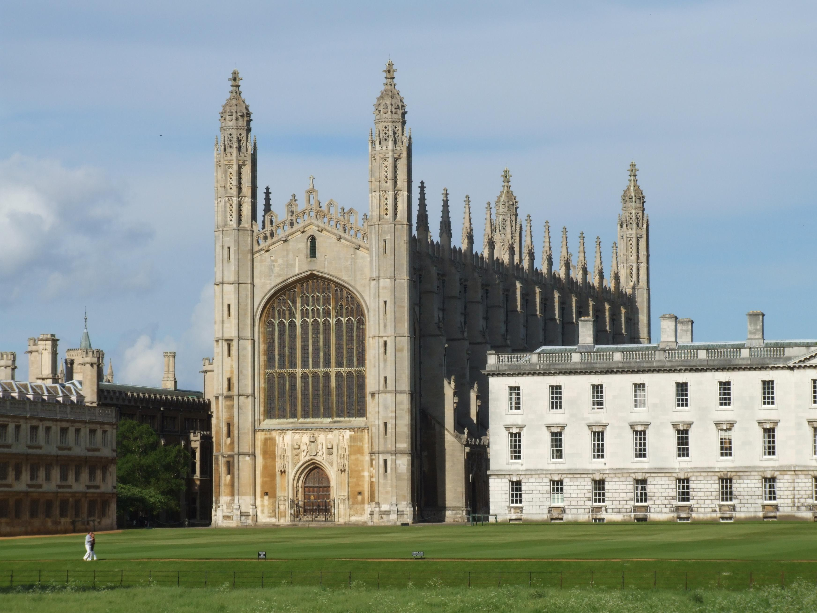

Slide 4
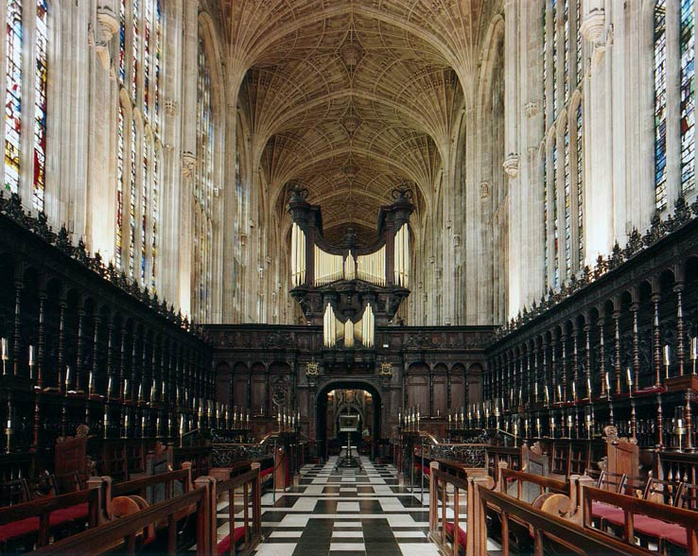

Slide 5
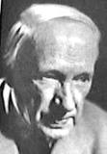
G. E. MOORE

Slide 6
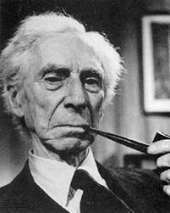
BERTRAND RUSSELL

Slide 7
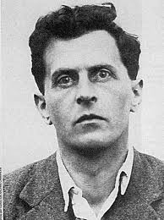
LUDWIG WITTGENSTEIN

Slide 8
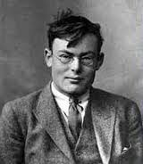
FRANK P. RAMSEY

Slide 9
ARGUMENTS FROM DESIGN AND ARGUMENTS FROM ETHICAL PREMISES
Broad defers to the criticisms of Immanuel Kant and David Hume of the Argument from Design. He knows of no effective rebuttal of their criticisms – therefore he (Broad) will not discuss the first of these.
On the second, he has responded elsewhere.

Slide 10
ANALOGY BETWEEN EAR FOR MUSIC AND SUSCEPTIBILITY TO MYSTICAL EXPERIENCE
There are a number of significant analogies between various ways of studying the one and the other (p. 76), but the important disanalogy is that mystical experiencers claim to come to know that something is true or probable as a result of their experience.

Slide 11
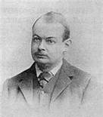
JOHN McTAGGART ELLIS McTAGGART

Slide 12
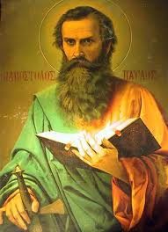
ST. PAUL

Slide 13
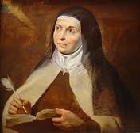
ST. TERESA OF AVILA

Slide 14
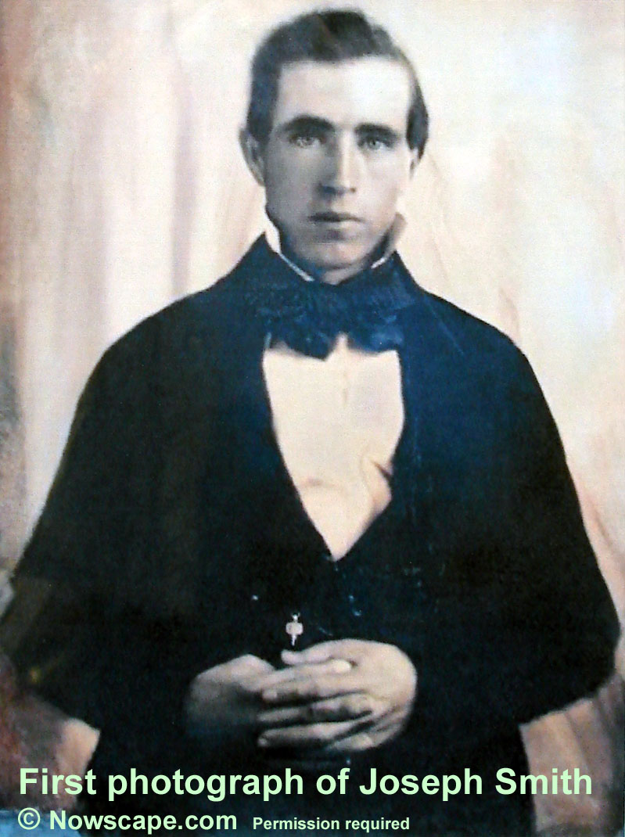
JOSEPH SMITH

Slide 15
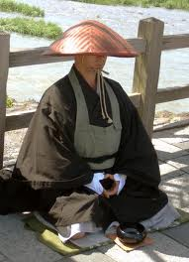
ZEN BHUDDIST

Slide 16
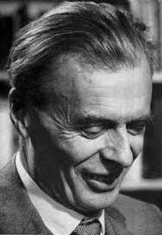
ALDOUS HUXLEY

Slide 17
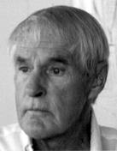
TIMOTHY LEARY

Slide 18
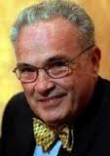
CARLOS CASTANEDA

Slide 19
ANALOGY BETWEEN EAR FOR MUSIC AND SUSCEPTIBILITY TO MYSTICAL EXPERIENCE
There are a number of significant analogies between various ways of studying the one and the other (p. 76), but the important disanalogy is that mystical experiencers claim to come to know that something is true or probable as a result of their experience.

Slide 20
RELIGIOUS EXPERIENCE RAISES THREE PROBLEMS (p. 76)
What is the psychological analysis of religious experience?
(ii) What are the genetic and causal conditions for the existence of religious experience?

Slide 21
Ad (ii): Genetic and Causal Conditions
Can we trace the origin and development of the disposition to have religious experiences -
(a) in the human race, and in
(b) each individual?

Slide 22
A THIRD PROBLEM ABOUT RELIGIOUS EXPERIENCE
Part of the content of some religious experiences is alleged knowledge (or well-founded belief) about the nature of Reality.
Are such experiences veridical – or at least true and probable?

Slide 23
A DISANALOGY WITH PROBLEM (iii)?
There are analogies of problems (i) and (ii) with musical experience. But (according to Broad) there is no analogy in that case with (iii).

Slide 24
DIGRESSION: AESTHETIC REALISM
Is Broad right about this? It depends on the answer to a question about Aesthetics (a sub-discipline of Philosophy). Are there objective facts about Beauty and Aesthetic Value? (And if there are, how do we know them?)

Slide 25
SOME ALLEGEDLY OBJECTIVE AESTHETIC JUDGMENTS
BEETHOVEN’S NINTH SYMPHONY IS BETTER MUSIC THAN THE COUNTRY WESTERN SONG “I LIKE MY WOMEN A LITTLE ON THE TRASHY SIDE”.
MICHELANGELO’S PIETA IS A GREATER WORK OF ART THAN MARCEL DUCHAMP’S FOUNTAIN.
GRACE KELLY WAS MORE BEAUTIFUL THAN MARJORIE MAIN

Slide 26
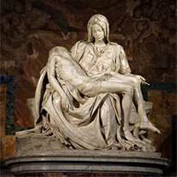
MICHELANGELO’S PIETA

Slide 27
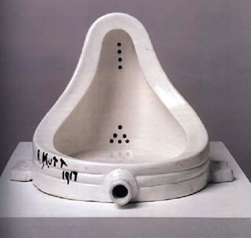
MARCEL DUCHAMP’S FOUNTAIN

Slide 28
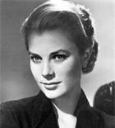
GRACE KELLY

Slide 29
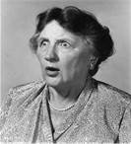
MARJORIE MAIN

